Slide 1
Consistency-Enhanced Story Generation
Team Members: Debashish Roy (2021201034)
Mentor: Bhavyajeet Singh
Professor: Dr. Manish Shrivastava

Slide 2
Problem Description
I will be generate story based on the prompt provided. I have used pretrained architectures GPT-2 for story generation. GPT-2 often struggles to maintain consistency and often ends up generating content incoherent with the given prompt for a generation. Story generation revolves around some common character and revolves around a plot. We are using a 2-step approach to story generation involving the generation of a plot outline based on the prompt followed by the actual generation of the story.

Slide 3
Dataset
We are using the Writing Prompt Dataset by FAIR. This is used to generate consistent stories by Hierarchical Neural Story Generation (Fan et al., 2018). Data is separated into prompt and story. This is extracted from Reddit, where one user will come up with a prompt and a single story and another will write a story revolving around that prompt.
The dataset is already divided into test, train, and validate. Test.wp_source contains prompts and corresponding to that test.wp_target contains stories. The size of the complete data is around 1 GB. The data is hosted on https://www.kaggle.com/datasets/ratthachat/writing-prompts.

Slide 4
Converting Data to suitable format
We have converted the dataset in the format The format of the dataset is
[ WP ] PROMPT <endprompt> OUTLINE <endoutline> TOP 10 KEYWORD/ PHRASE. Where the outline is generated using the Text Rank algorithm. And Top 10 keywords are found using the RAKE algorithm.

Slide 5
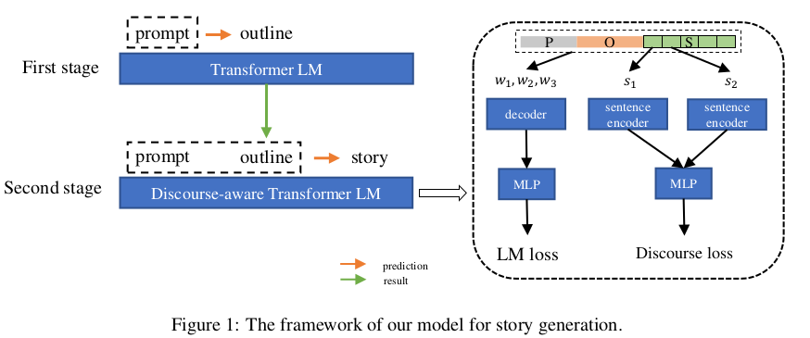
Architecture

Slide 6
Training: We have used the gpt2 model and fine tuned it as per our use case. It is used to generate outlines. We concatenate prompt X and outline Z with <SEP> token to get a sequence X0. For training, we compute the cross-entropy of all tokens in X0 as a normal language model.
Testing: While testing has given the prompt tokens as context, the model generates outline tokens.
I have used Top-k and Top-p selection strategies. Top-k allows us to choose the next word from top-k probability, and then sample from it. Whereas Top-p picks amongst the top tokens whose probabilities add up to p.

Slide 7
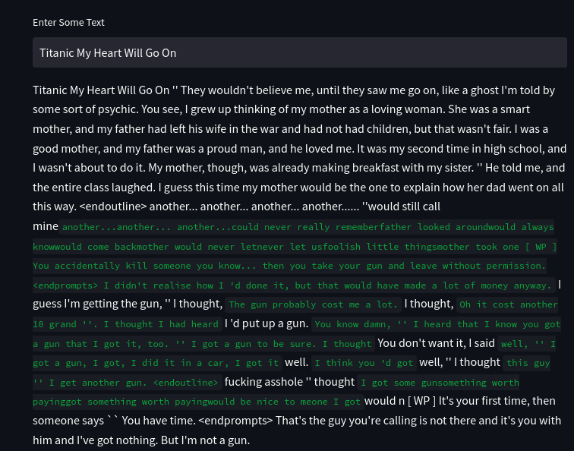
Deployment

Slide 8
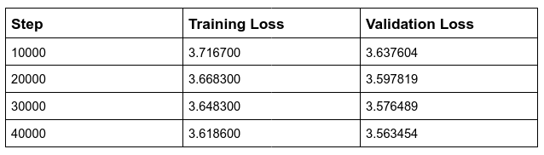
Training and Evaluation Loss:

Slide 9
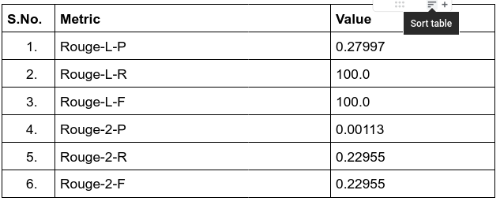
Evaluation Mechanism and Results

Slide 10
Analysis
Mentor suggested analyzing validation loss along with the training loss, to get an idea that the model is learning anything or not.
Since both are decreasing we reached the conclusion that it is learning something.
The result given by the model has a high Rouge-L-R score since the model at least replicates what the prompt is provided and considering it in the longest common subsequence we get a perfect match.
Rouge score is not perfect. A story can be written in many forms with the same meaning and it will give a high score with the words that it will match.
Accuracy needs to be improved. One of the causes is that the coherence between the sentences is not too high.

Slide 11
Thank You!!!

